Slide 1
DEBUGGING
PRESENTED BY:
E.KOHITHA
P.KEERTHANA
SAI SHIVANI
HIRA NAJAM

Slide 2
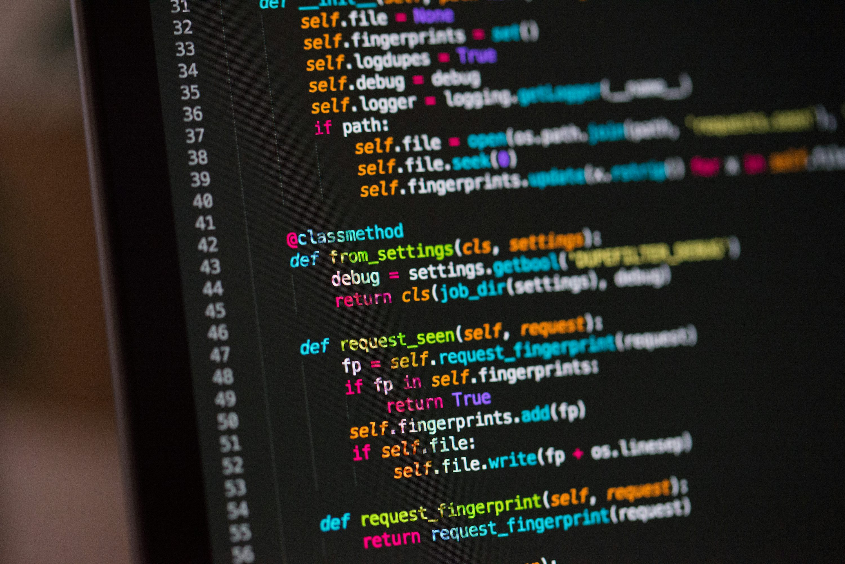
INTRODUCTION TO DEBUGGING
Debugging is the process of finding and fixing errors in a program
Errors in a program are commonly called bugs.
Developers use debugging tools to find the exact source of the problem.
After fixing the bug, the program is tested again to make sure it works properly.
It helps identify why the program is not working correctly.

Slide 3
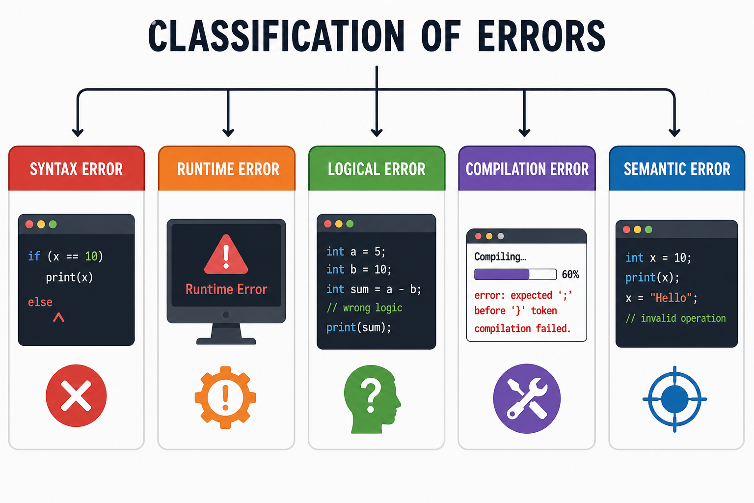
TYPES OF ERRORS
Syntax Error
Runtime Error
Logical Error
Compilation Error
Semantic Error

Slide 4
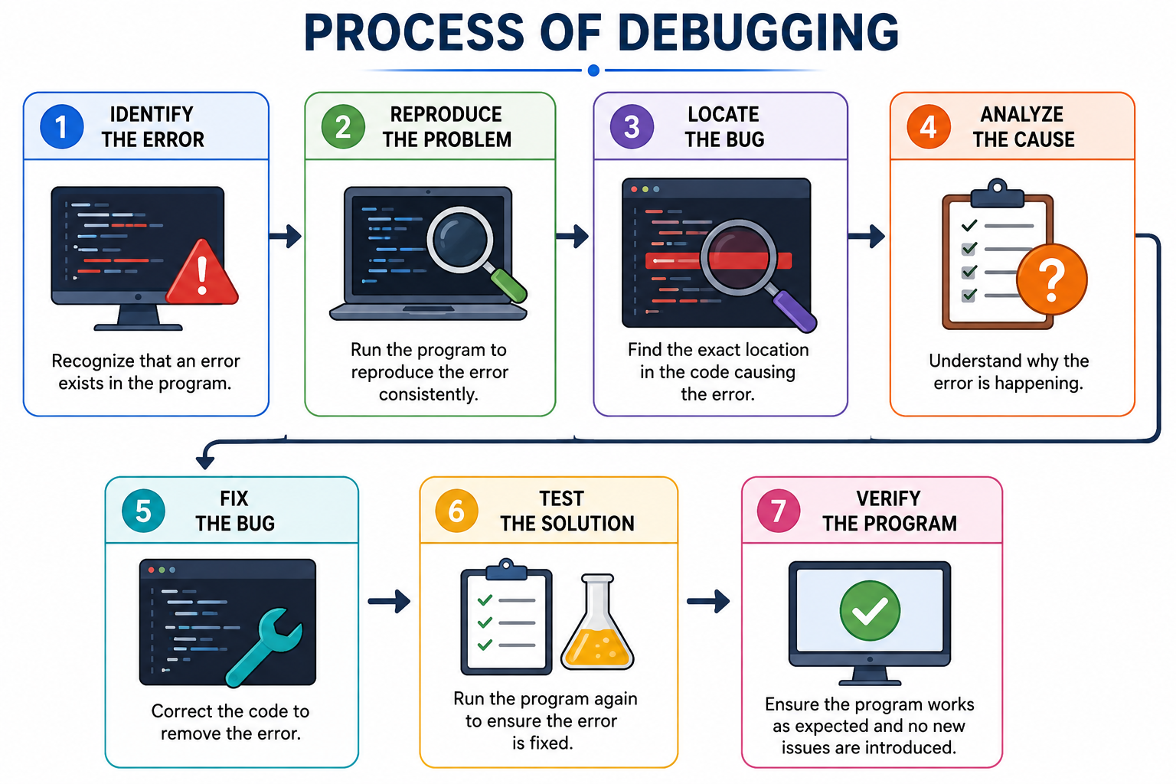
DEBUGGING PROCESS
Identify the Error
Reproduce the Problem
Locate the Bug
Analyze the Cause
Fix the Bug
Test the Solution
Verify the Program

Slide 5
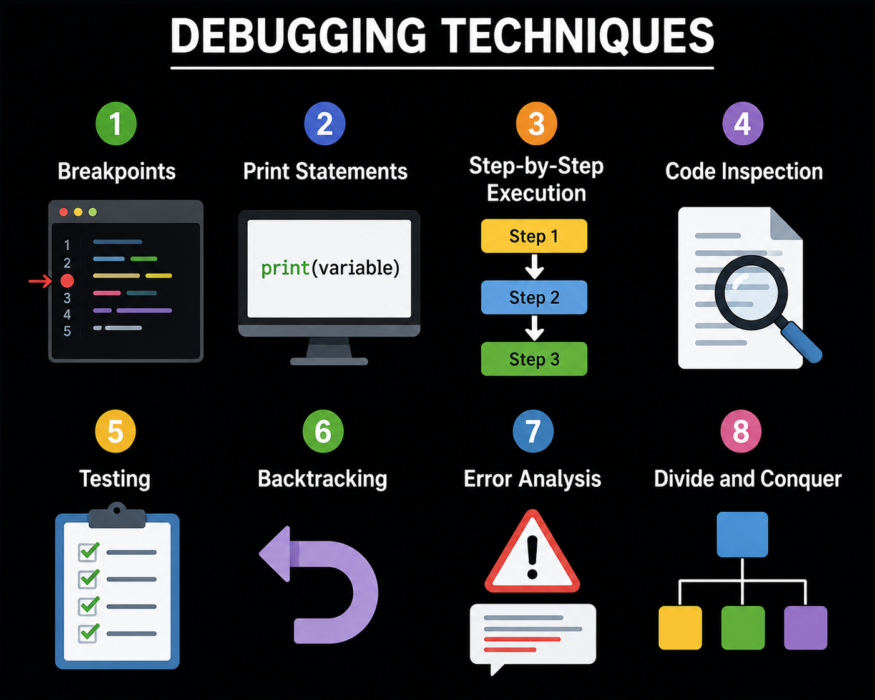
DEBUGGING TECHNIQUES
Breakpoints
Print Statements
Step-by-Step Execution
Code Inspection
Testing
Backtracking

Slide 6
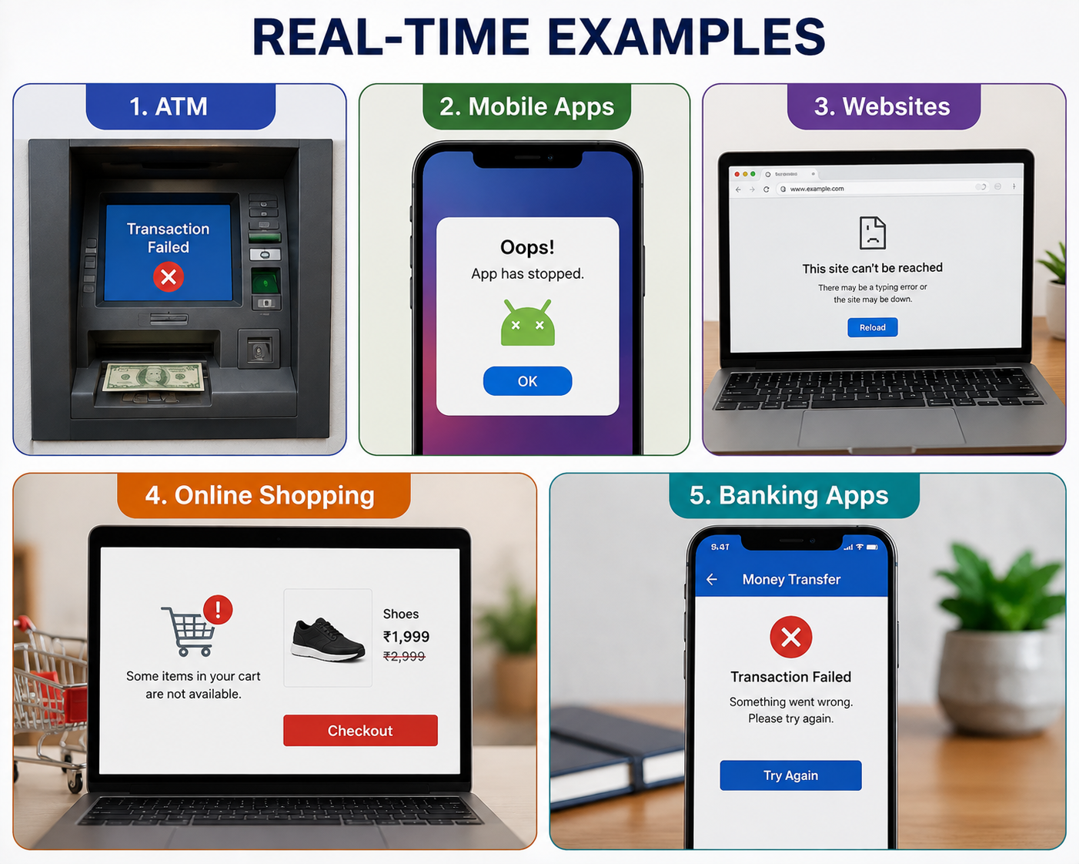
REAL TIME EXAMPLE
ATM
Mobile Apps
Websites
Online Shopping
Banking Apps

Slide 7


ADVANTAGES
Improves code quality
Finds errors quickly
Saves development time
Improves program performance
Increases software reliability

Slide 8

DISADVANTAGES
Time-consuming
Requires skilled developers
Can delay project delivery
May increase development costs
Complex bugs are difficult to find

Slide 9
CONCLUSION
To conclude, debugging plays an important role in making a program work properly. Errors are common while writing code, but debugging helps us identify where the problem occurs and correct it. It also helps improve the quality, performance, and reliability of software. By carefully testing and fixing errors, developers can create programs that are more accurate and user-friendly. So, debugging is not just about fixing mistakes, but also about making software better and more dependable.

Slide 10
THAnK YOU

